Slide 1
Time Series in R
Practical Data Science Meetup
By Mark Nielsen
Blog: nielsenmark.us
GitHub: github.com/nielsenmarkus11
Notes:
Introduce myself: Utah State and BYU for MS in statistics, Merrick Bank – Risk Analyst for 5 years, Intermountain Healthcare – Population Health almost 2 years.
Time series is that course I always wished I took in college.

Slide 2
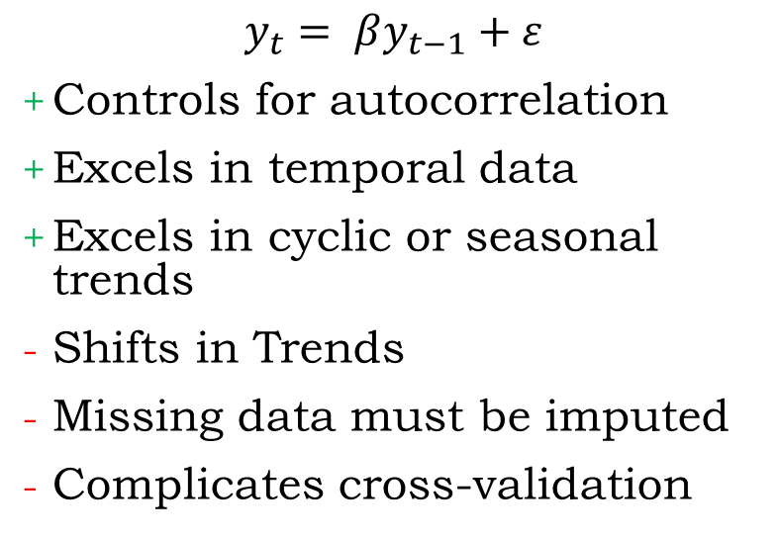
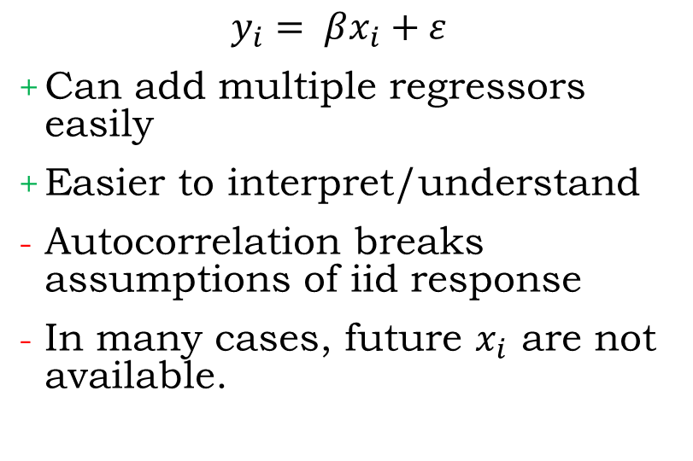
Time Series vs. Linear Regression
Time Series
Linear Regression
$$y_{t}= βy_{t−1}+ε$$
Controls for autocorrelation
Excels in temporal data
Excels in cyclic or seasonal trends
Shifts in Trends
Missing data must be imputed
Complicates cross-validation
$$y_{i}= βx_{i}+ε$$
Can add multiple regressors easily
Easier to interpret/understand
Autocorrelation breaks assumptions of iid response
In many cases, future $x_{i}$ are not available.
Notes:
So, why time series?
This is “Practical Data Science” so this is the most math you’ll see in this presentation.
iid = “independent and identically distributed”

Slide 3
Time Series Examples
Financial
Stock Market Pricing Index
Reserve Planning
Health Care
ER visits forecast
Staffing
Total Medical Expense
Social
Tweet, post, etc. trends
Bike share forecasting
Environmental
Weather forecasts
Pollution
Etc.
Notes:
Here are a few examples of data that could be modeled as time series.
Cyclic
Seasonality
Autocorrelation (correlation to prior values of data)

Slide 4
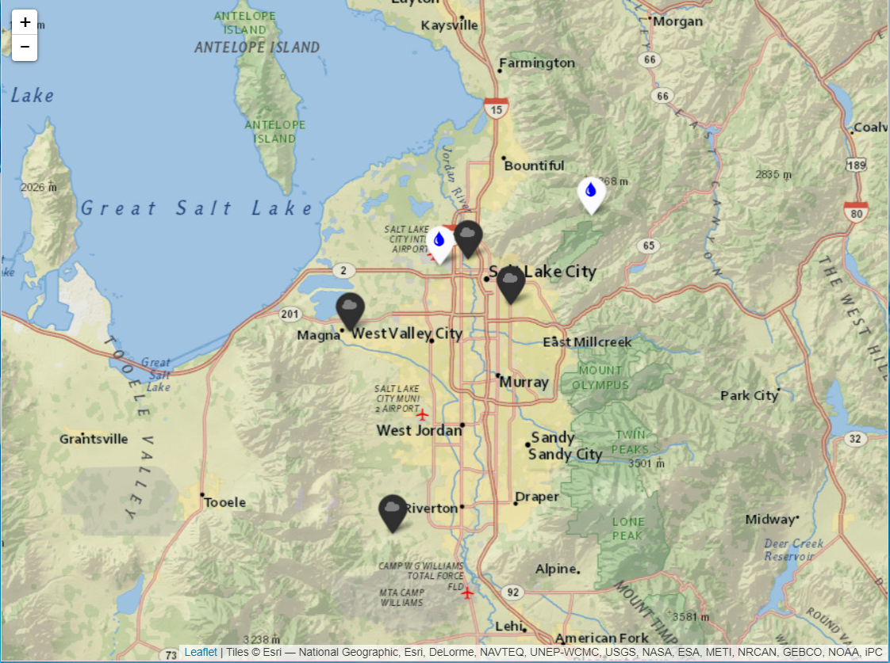
Air Quality and Weather Data
Daily PM 2.5
Inversion (Valley - Peak Temperature)
Wind Speed
Precipitation
Firework Holidays
Notes:
In this demo, I’ll be using data obtained from the EPA and National Center for Environmental Information.
Inversion is where Valley temperature is colder than at the Peak, which essentially puts a “cap” on the valley, not allowing air to escape.
Firework holidays are New Years, week of July 4th and week of July 24th.

Slide 5
Modeling Demo in R

Slide 6
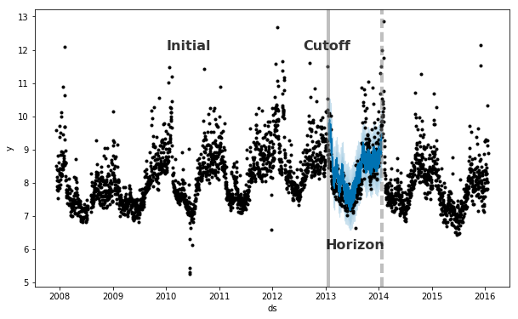
Time-Series Cross-Validation
Photo Credit: Prophet Online Docs https://facebook.github.io/prophet/docs/diagnostics.html
Notes:
How do we cross-validate in time series?
We take a rolling window and split it into two parts:
Initial period
Horizon
Move our window forward and repeat.
This provides us the ability to compute the residuals for each time period in the horizon. Once we have this we can compute a number of loss functions. I’ll be using RMSE (root mean squared error).

Slide 7
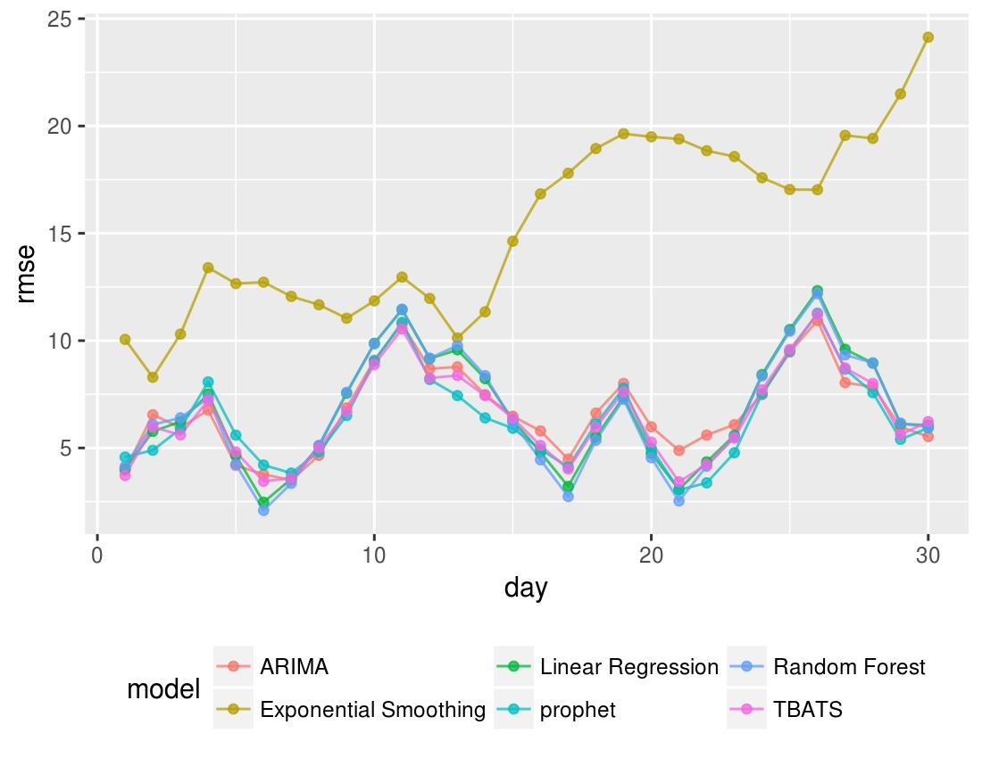
RMSE for the Horizon
ETS doesn’t do so well since it is only considering weekly seasonality.
Linear Regression, Random Forest, TBATS, ARIMA and Prophet all perform similarly.
Notes:
Ironically, in this data, the regression methods (OLS and RF) performed very similarly to Prophet, ARIMA, TBATS, etc.
ETS doesn’t seem to be a good fit for this data.

Slide 8
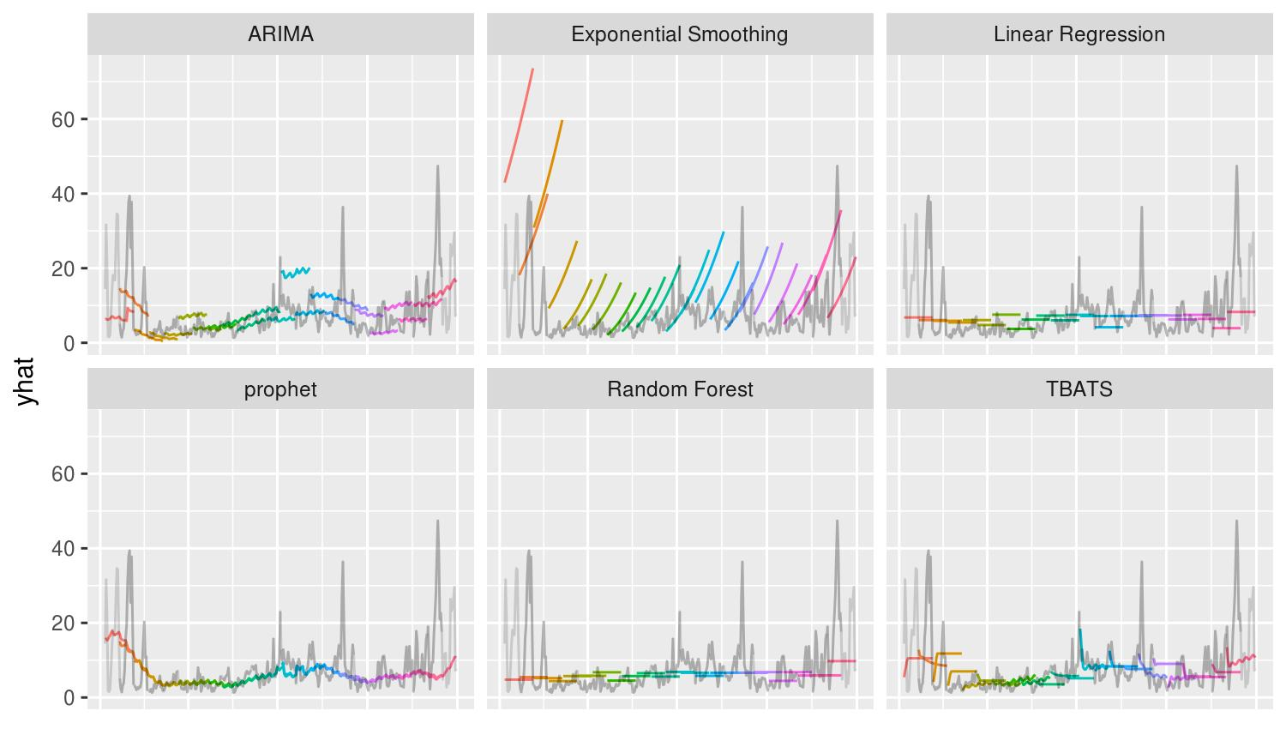
Notes:
A few things to notice here:
ARIMA appears to not be robust enough for shifts in the trend.
ETS is not a good fit, limited to one seasonality.
Both Linear and RF regression are straight lines since I purposely just picked the last value for weather forecasts
Both Prophet and TBATS seem to be ale to adjust… however as you get further out in TBATS it tends toward an average.

Slide 9
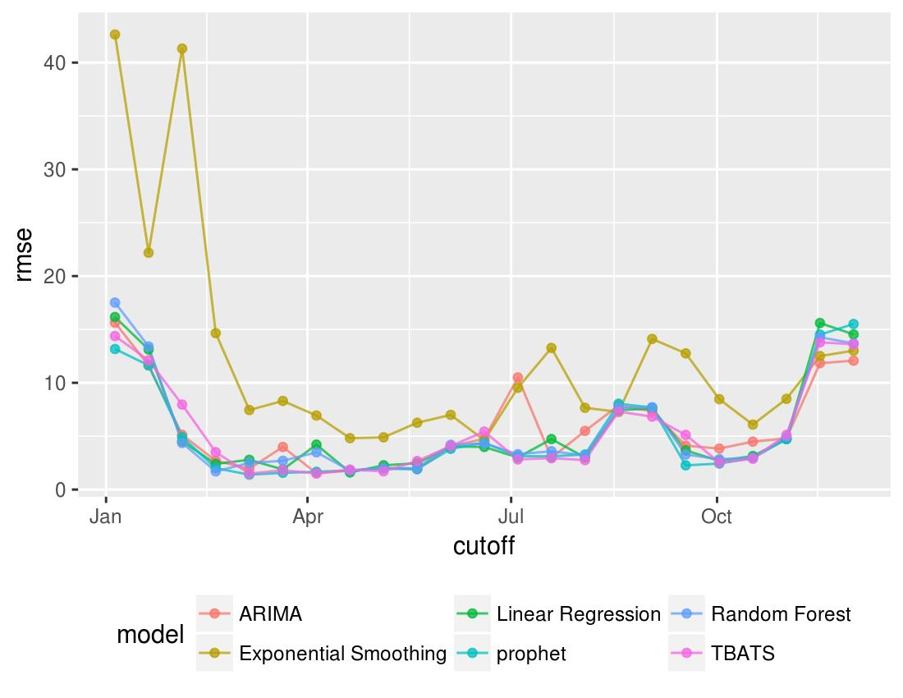
RMSE for the Cutoff Date
Notice that all models don’t do well in months with high PM2.5.
September 2017 was particularly difficult for all models. Any guesses why?
Notes:
See a bump in the high PM2.5 months. When we have high levels of PM2.5, they can be really high. I’ve used the square-root transformation of PM2.5 to help adjust for this in my models.
But still these time periods are more difficult to predict than low PM2.5 months.
I was seeing one the beginning of July, but once adjusting for Fireworks it dropped down.

Slide 10
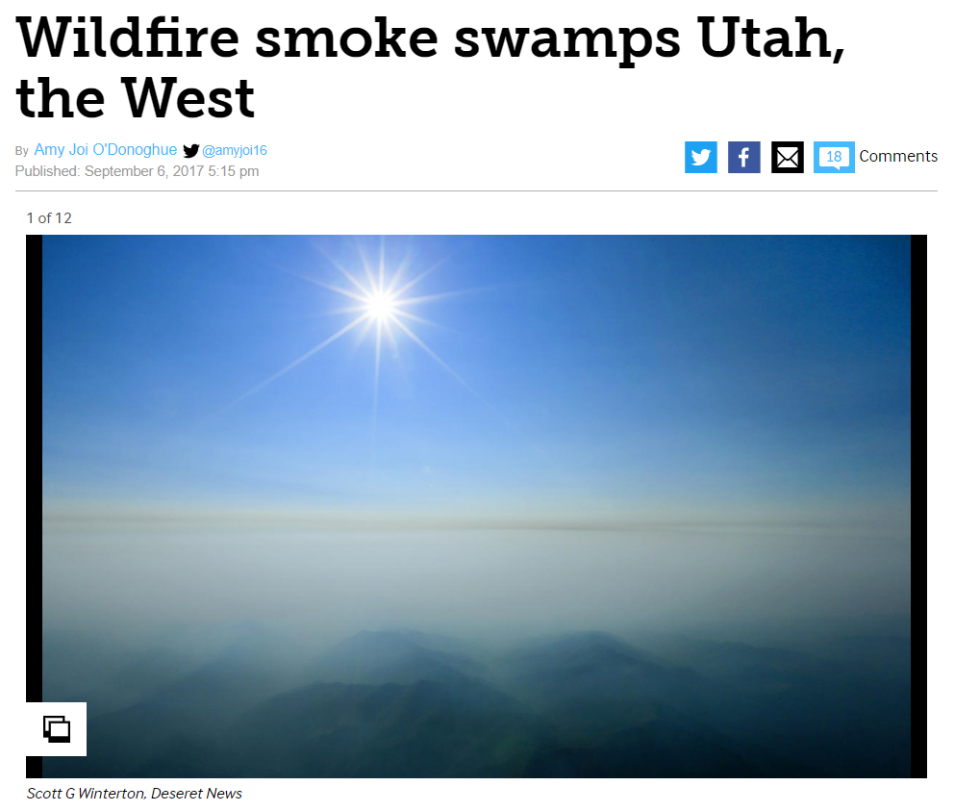

Slide 11
Where to start?
FutureLearn Forecasting MOOC:
https://www.futurelearn.com/courses/business-analytics-forecasting
Forecasting: Principles and Practice:
http://otexts.org/fpp/
Prophet: Forecasting at Scale:
https://facebook.github.io/prophet/
Notes:
Did this feel like a firehose? Well, if so… here are some great resources to expand your knowledge of time series.

Slide 12
References
Hyndman, R.J. and Athanasopoulos, G. (2013) Forecasting: principles and practice. OTexts: Melbourne, Australia. http://otexts.org/fpp/. Accessed on February 11, 2018.
National Center for Environmental Information. Climate Data Online available at https://www.ncdc.noaa.gov/cdo-web. Accessed February 11, 2018.
Sean Taylor and Ben Letham (2017). prophet: Automatic Forecasting Procedure. R package version 0.2.1.9000. https://facebook.github.io/prophet/.
US Environmental Protection Agency. Air Quality System Data Mart [internet database] available at http://www.epa.gov/ttn/airs/aqsdatamart. Accessed February 11, 2018.

Slide 13
Questions?

